Slide 1

White Wine Quality Prediction
IST 707 – Final Project
Omar Hanif, Eli Rivera, Elizabeth Westbrook

Slide 2


Introduction
The project looks at the 12 attributes of white wines in order to determine if we can predict the wine quality score with any combination of those attributes. Essentially, the project aims to identify the relationship (if there exists one) of the available variables with the target variable: wine quality.
Because wine quality ratings are subjective, enologists would be well-served by having objective measures that can help determine a wine's quality, and with the quality determined, they can take steps to improve the quality.
Wine quality is assessed based on much more than flavor and opinion. Many attributes are evaluated to help score a wine’s quality.
Data Source: https://archive.Ics.Uci.Edu/ml/machine-learning-databases/wine-quality/

Slide 3
EDA
The data set is complete; there are no missing values. There are no obviously incorrect values; Outliers are not too far outside the ranges of each attribute.
It consists of 4,898 rows and 12 columns (variables).
Quality is a discrete variable while all the input variables are continuous; however, quality requires discretization. For analysis, it is discretized into two bins: "good" and "bad."

Slide 4
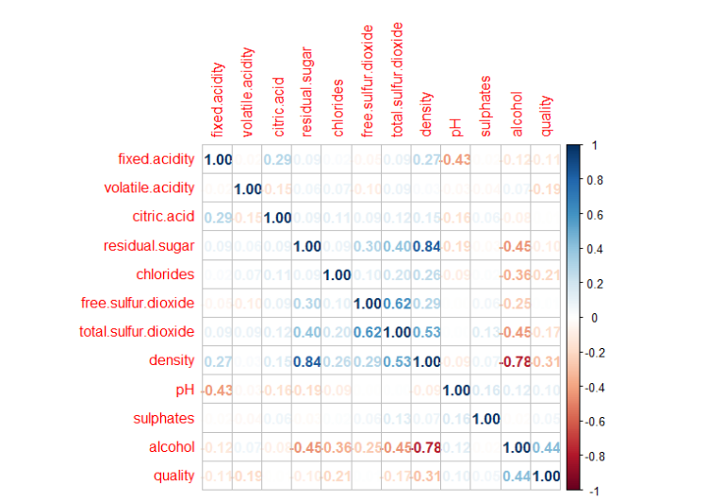
The two strongest correlations with quality are moderate positive correlation to alcohol and moderate negative correlation with density. Additionally, alcohol is negatively correlated with density of wine. Density is strongly positively correlated with residual sugar quantity and moderately correlated with ph. Free sulfur dioxide and total sulfur dioxide are strongly correlated.

Slide 5
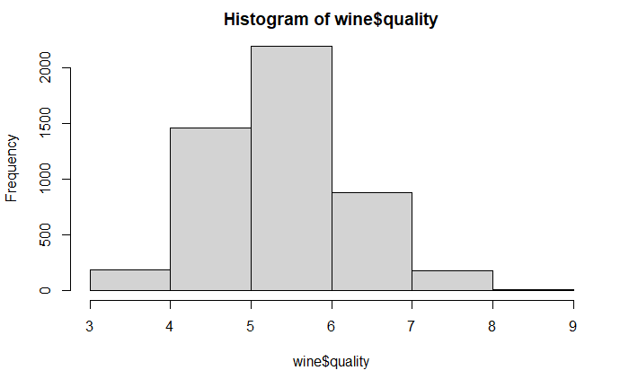
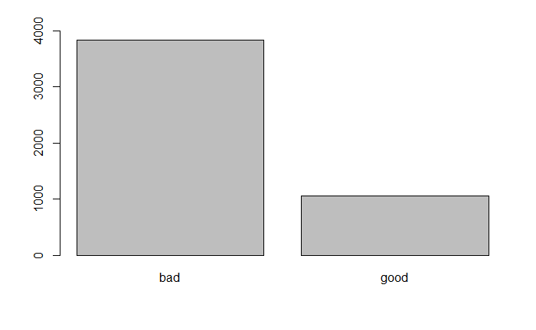
Distribution
Before discretization
After discretization (>= 7)

Slide 6
preprocessing
Rather than making this a regression task to predict the integers in the quality attribute, we made it into a classification task
To classify wine quality, we discretized the quality attribute and binned each observation as either "good" or "bad"
Good >= 7
Bad < 7
75% of the dataset was used for the training set; the remaining 25% went into the test set
Preprocessing of all models done within model training with center and scale
For reproducible results, the seed was set to 424

Slide 7
Caret package
Using Train parameter with naïve_bayes method

Slide 8
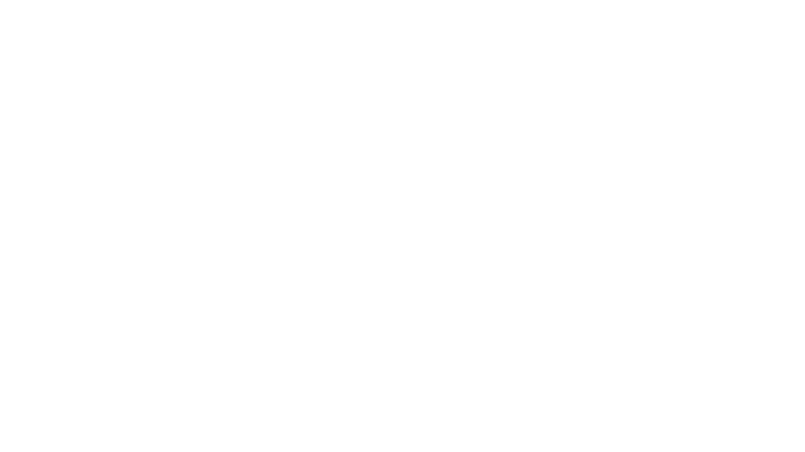
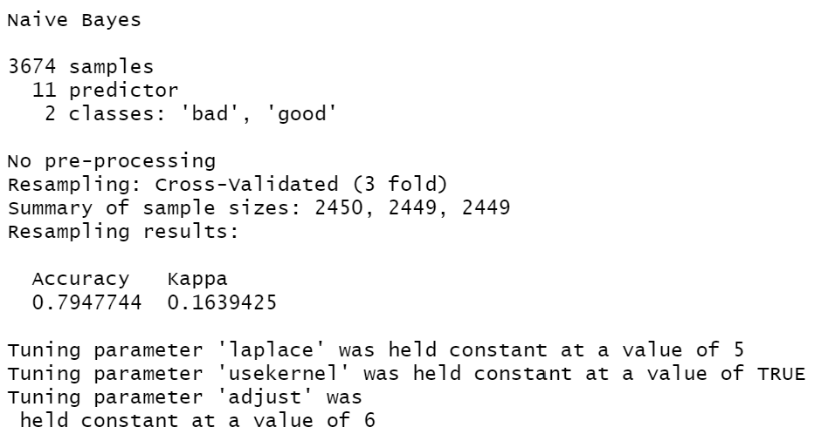
Model Results
3 folds cross validation
Accuracy = %79

Slide 9
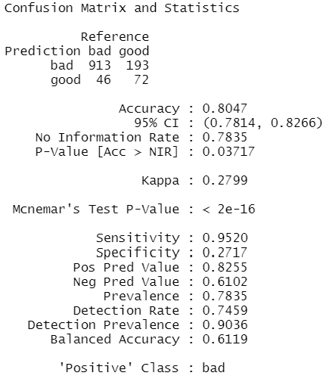
Confusion matrix Results
Accuracy = %80

Slide 10
E1071 package
Using naïve Bayes parameter
klar package

Slide 11
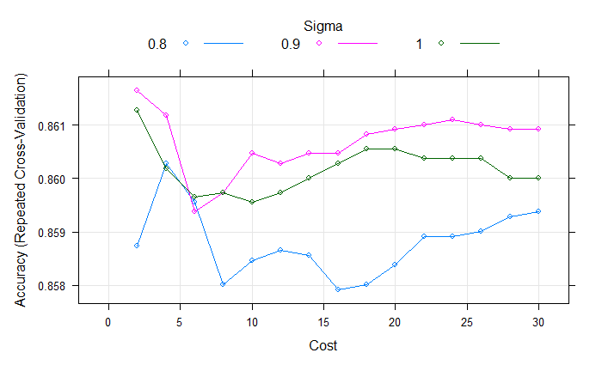
SVM Models
Three kernels:
Confusion matrix and statistics
Reference
Prediction bad good
Bad 923 117
Good 36 148
Accuracy : 0.875
95% ci : (0.8552, 0.893)
No information rate : 0.7835
p-value [acc > nir] : < 2.2e-16
kappa : 0.5857
Linear
Radial basis function (RBF)
Polynomial
Best performer:
RBF
Sigma: 0.9
Cost: 2

Slide 12
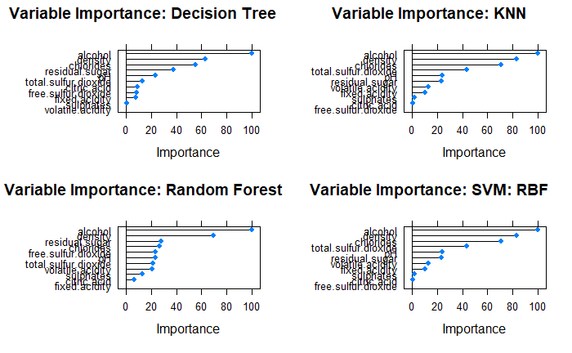
Variable Importance
Across all models
Alcohol content was the most important variable in determining a wine’s quality
Density was consistently ranked 2nd

Slide 13
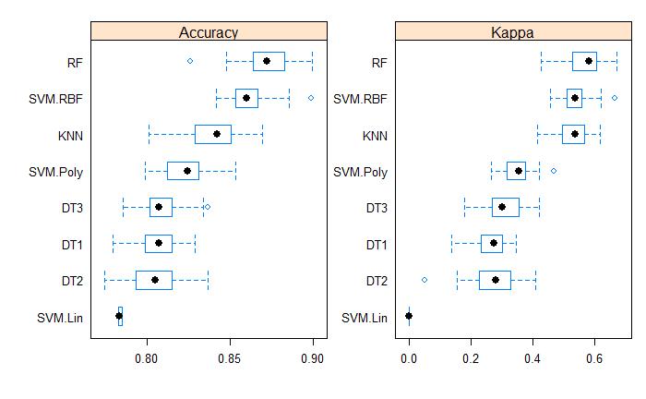
Model Comparison
BEST PERFORMERS
Random forest
88.81%
SVM—RBF
87.5%
KNN
85.54%

